Slide 1
Chapter 2
PIG

Slide 2

Topics
Pig overview.
Execution modes.
Pig Latin Basics.
Developing Pig Script.

Slide 3
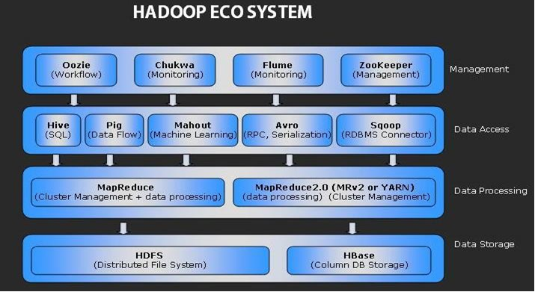

Slide 4
Pig Definition :
is a platform for analyzing large data sets that consists
of a high-level language for expressing data analysis
programs, coupled with infrastructure for evaluating
these programs.
Pig is widely used and accepted by
Yahoo!, Twitter, Netflix etc.

Slide 5
Pig and Map reduce:
Map reduce programmers need to think programmes in terms of map and reduce functions.
It normally requires JAVA programmers.
Pig requires its own scripting language named ‘Pig Latin’.

Slide 6
Pig’s Features:
Join Datasets.
Sort Datasets.
Data Types.
Group By.
Etc..

Slide 7
Pig Components:
Pig Latin :
Command based language.
Designed specifically for data transformation and flow expression.
Execution Environment :
The environment in which Pig Latin commands are executed .
Currently it supports local and Hadoop modes.
Pig compiler converts Pig Latin into Map Reduce
Compiler strives to optimize execution.

Slide 8
Execution Modes:
There are 2 execution modes supported by Pig :
To enter into different modes :
$Pig –x local (for local mode)
$Pig –x mapreduce (for hadoop mode)
Pig
Local Mode
Hadoop Mode

Slide 9
Pig Latin Concepts:
Building Blocks :
Field – Piece of data.
Tuple – ordered set of fields represented with “(“and“)” can also be referred as collection of fields.
Example : (abc, 12, M, 1000).
3) Bag – collection of tuples can be also represented with
“{“and”}”.
Example : {(abc, 12, M, 1000), (xyz, 14, F, 2000)}.

Slide 10
Working :
Script
Pig Latin
Pig Engine
Compile
Optimize
Execution Plan
Execute

Slide 11
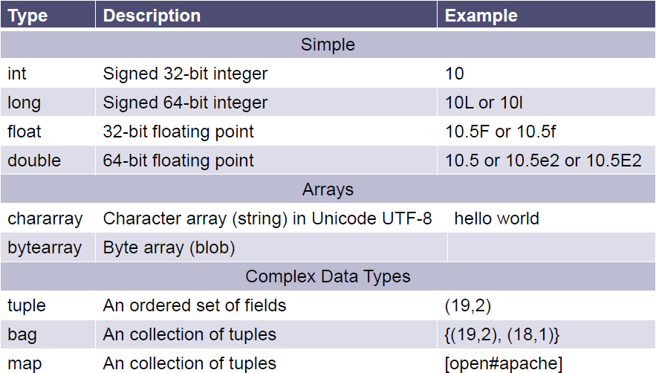
Schema Data Types:

Slide 12
Pig LOAD Command:
LOAD ‘data’ [USING Function] [AS schema];
data – name of the directory or file usually in single inverted commas.
USING – specifies the load function to use. By default uses PigStorage which parses each line into fields using delimiter as \t etc.
AS – assigns a schema to incoming data.
assigns names to fields.
declares types to fields.

Slide 13
Simple Pig Example:
Start grunt with default mapreduce mode.
$ pig
grunt> cat /training/playarea/pig/a.txt
A 100
B 200
C 300
grunt> records= LOAD ‘/training/playarea/pig/a.txt’
USING PigStorage() AS (letter:chararray, count:int);
grunt> dump records;
(A,100)
(B,200)
(C,300)
Create text file using cat command
Load data into records
Display result using dump command
Output

Slide 14
Dump and Store commands
No action will be taken unless dump and store commands are executed in Pig.
Dump :
Dump is used to display the results.
2) Store :
Store is used to save the results.
Hadoop data is usually too large so it is not always feasible to print it to the screen so usually it gets stored in the Hadoop (HDFS, Hbase).

Slide 15
Pig Latin - Grouping
grunt> chars = LOAD ‘/training/playarea/pig/b.txt’ USING PigStorage() AS (c:chararray);
grunt> dump chars;
(a)
(b)
(k)
:
(k)
grunt> charGroup = GROUP chars by c;
grunt> dump charGroup;
(a,{(a),(a)})
(b,{(b),(b),(b)})
The chars bag is grouped by “c” therefore ‘group element will contain unique values
Creates a new bag with element named group and element named chars
‘chars’ element is a bag itself and contains all tuples from ‘chars’ bag that match the values from ‘c’

Slide 16
Pig Latin Diagnostic tools:
Display the structure of Bag
grunt> DESCRIBE <bag_name>;
Illustrate how Pig engine transforms data
grunt> ILLUSTRATE <bag_name>;

Slide 17
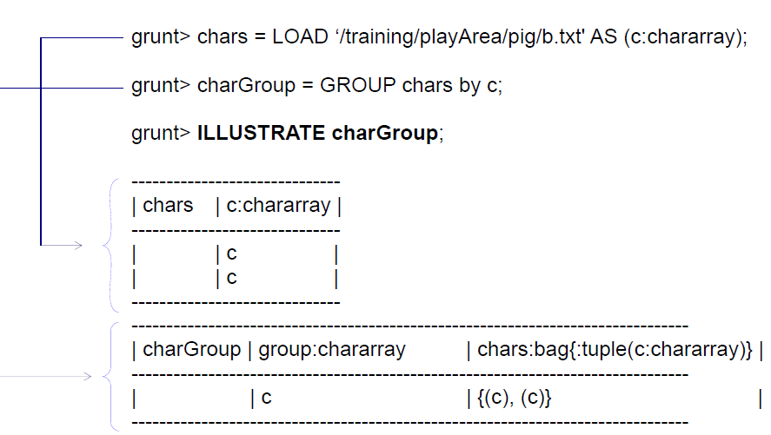
ILLUSTRATE Command:

Slide 18
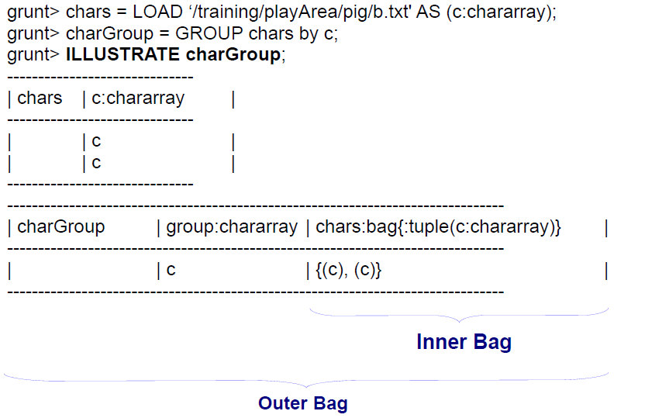
Inner and Outer Bags:

Slide 19
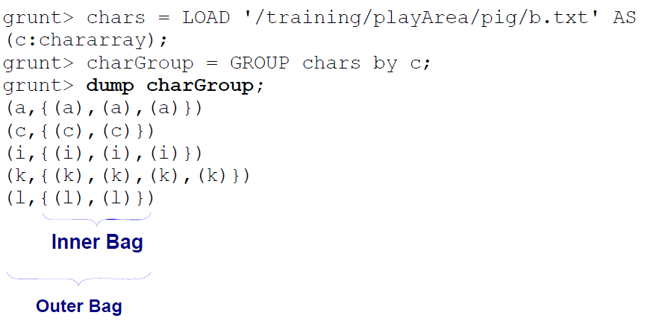
Example of Inner Bag and Outer Bag:

Slide 20
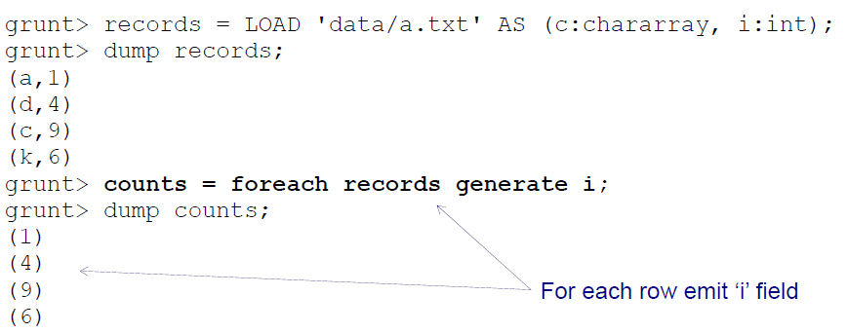
Pig Latin - FOREACH
FOREACH <bag> GENERATE <data>
Iterates over each element in a bag and produces a result

Slide 21
FOREACH with Functions
FOREACH B GENERATE group, FUNCTION(A);
Pig comes with many functions including COUNT, FLATTEN, CONCAT etc.
grunt> chars = LOAD ‘data/b.txt’ AS (c:chararray);
grunt> charGroup = GROUP chars by c;
grunt> dump charGroup;
(a,{(a),(a)})
(b,{(b),(b),(b)})
(c,{(c)})
grunt> counts = FOREACH charGroup GENERATE group, COUNT (chars);
grunt> dump counts;
(a,2)
(b,3)
(c,1)
For each row in ‘charGroup‘ bag emit group field and count the number of items in ‘chars’ bag

Slide 22
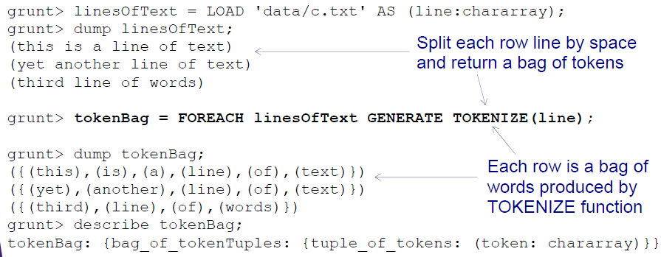
TOKENIZE Function:
Splits a string into tokens and outputs as a bag of tokens.
Seperators are space, comma(,), double quote(“”), parenthesis(()), star(*).

Slide 23
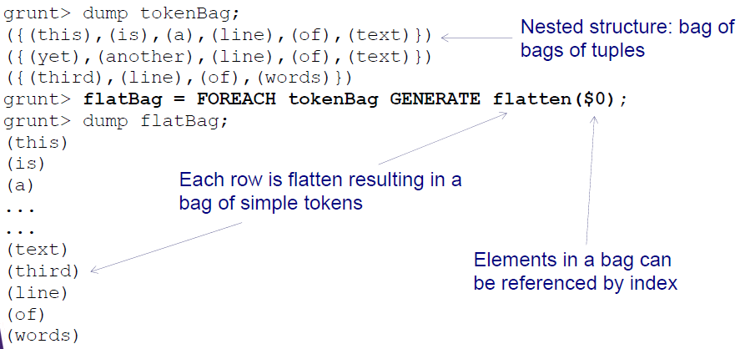
Flatten Function:
Rearranges the output.

Slide 24
Pig Latin - JOINS
Pig supports
Inner Joins.
Outer Joins.
Full Joins.
How to Join in Pig?
Load records into a bag from input #1.
Load records into a bag from input #2.
Join the two bags by provided join key.

Slide 25
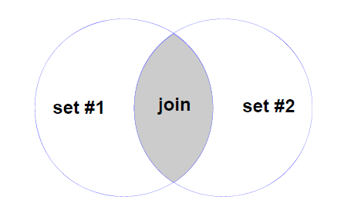
Inner Join:
Inner Join is termed as a Default Join.
Rows are joined where the keys match.

Slide 26
Inner Join Example:
1) Load records into a bag from input #1.
grunt> posts = load ‘/training/data/user-posts.txt’ using PigStorage(‘,’) as (user:chararray, post:chararray, date:long);
2) Load records into a bag from input #2.
grunt> likes = load ‘/training/data/user-likes.txt’ using PigStorage(‘,’) as (user:chararray, likes:int, date:long);
3) Join the data sets.
grunt> userInfo = join posts by user, likes by user;
grunt> dump userInfo;

Slide 27
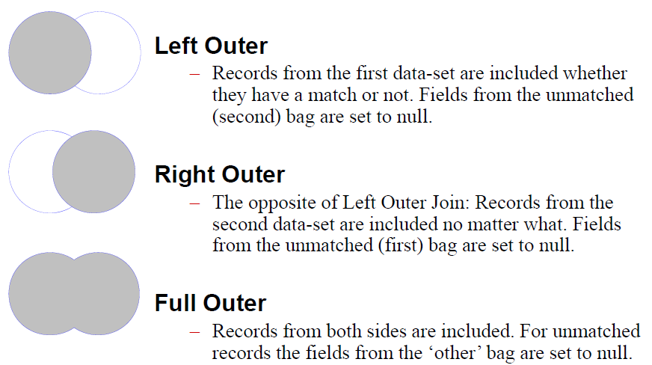
Outer Join:
Records which will not join with the other record set are still included in the result.

Slide 28
Left Outer Join example:
1) Load records into a bag from input #1.
grunt> posts = load ‘/training/data/user-posts.txt’ using PigStorage(‘,’) as (user:chararray, post:chararray, date:long);
2) Load records into a bag from input #2.
grunt> likes = load ‘/training/data/user-likes.txt’ using PigStorage(‘,’) as (user:chararray, likes:int, date:long);
3) Join the data sets.
grunt> userInfo = join posts by user LEFT OUTER, likes by user;
grunt> dump userInfo;

Slide 29
Right Outer Join example:
1) Load records into a bag from input #1.
grunt> posts = load ‘/training/data/user-posts.txt’ using PigStorage(‘,’) as (user:chararray, post:chararray, date:long);
2) Load records into a bag from input #2.
grunt> likes = load ‘/training/data/user-likes.txt’ using PigStorage(‘,’) as (user:chararray, likes:int, date:long);
3) Join the data sets.
grunt> userInfo = join posts by user RIGHT OUTER, likes by user;
grunt> dump userInfo;

Slide 30
Full Outer Join example:
1) Load records into a bag from input #1.
grunt> posts = load ‘/training/data/user-posts.txt’ using PigStorage(‘,’) as (user:chararray, post:chararray, date:long);
2) Load records into a bag from input #2.
grunt> likes = load ‘/training/data/user-likes.txt’ using PigStorage(‘,’) as (user:chararray, likes:int, date:long);
3) Join the data sets.
grunt> userInfo = join posts by user FULL OUTER, likes by user;
grunt> dump userInfo;

Slide 31
Introduction
Pig is a high-level programming language useful for analyzing large data sets. Pig was a result of development effort at Yahoo!
In a MapReduce framework, programs need to be translated into a series of Map and Reduce stages. However, this is not a programming model which data analysts are familiar with. So, in order to bridge this gap, an abstraction called Pig was built on top of Hadoop.
Apache Pig enables people to focus more on analyzing bulk data sets and to spend less time writing Map-Reduce programs. Similar to Pigs, who eat anything, the Apache Pig programming language is designed to work upon any kind of data.

Slide 32
Pig Architecture
The Architecture of Pig consists of two components:
Pig Latin, which is a language
A runtime environment, for running PigLatin programs.
A Pig Latin program consists of a series of operations or transformations which are applied to the input data to produce output. These operations describe a data flow which is translated into an executable representation, by Hadoop Pig execution environment. Underneath, results of these transformations are series of MapReduce jobs which a programmer is unaware of. So, in a way, Pig in Hadoop allows the programmer to focus on data rather than the nature of execution.
PigLatin is a relatively stiffened language which uses familiar keywords from data processing e.g., Join, Group and Filter.

Slide 33
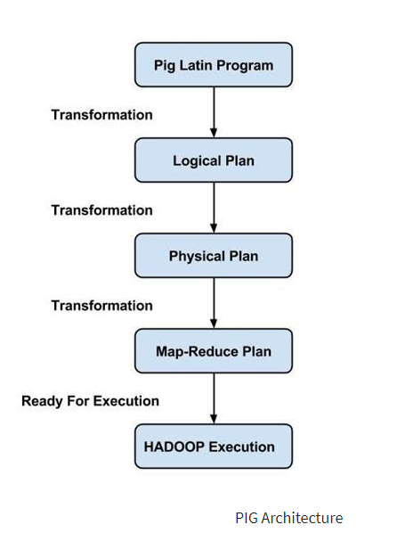

Slide 34
Execution modes:
Pig in Hadoop has two execution modes:
Local mode: In this mode, Hadoop Pig language runs in a single JVM and makes use of local file system. This mode is suitable only for analysis of small datasets using Pig in Hadoop
Map Reduce mode: In this mode, queries written in Pig Latin are translated into MapReduce jobs and are run on a Hadoop cluster (cluster may be pseudo or fully distributed). MapReduce mode with the fully distributed cluster is useful of running Pig on large datasets.

Slide 35
Pig Latin – Data Model
A Relation is the outermost structure of the Pig Latin data model. And it is a bag where −
A bag is a collection of tuples.
A tuple is an ordered set of fields.
A field is a piece of data.

Slide 36
Pig Latin – Statemets
While processing data using Pig Latin, statements are the basic constructs.
These statements work with relations. They include expressions and schemas.
Every statement ends with a semicolon (;).
We will perform various operations using operators provided by Pig Latin, through statements.
Except LOAD and STORE, while performing all other operations, Pig Latin statements take a relation as input and produce another relation as output.
As soon as you enter a Load statement in the Grunt shell, its semantic checking will be carried out. To see the contents of the schema, you need to use the Dump operator. Only after performing the dump operation, the MapReduce job for loading the data into the file system will be carried out.

Slide 37
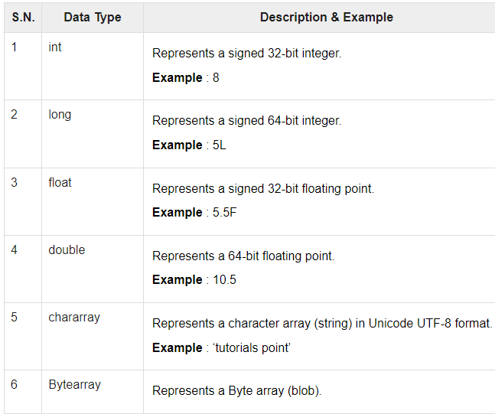
Pig Latin – Data types

Slide 38
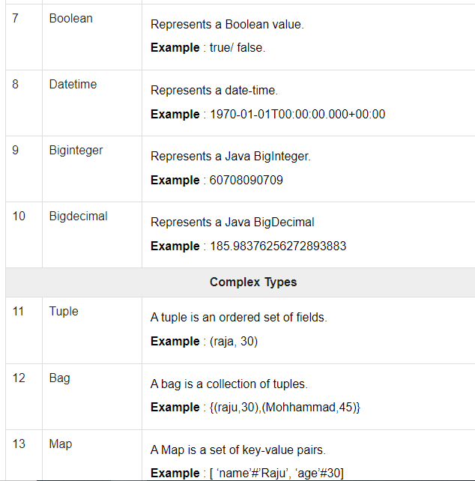
Pig Latin – Data types

